Slide 1


A Study of Three Static Analysis Tools

Slide 2

A Simple Study of Program Analysis Tools
Three Program Analysis tools
Requirements:
Open Source
Built for Windows
Different Context Availability
Chosen PA tools include: SonarQube, DevSkim, CppCheck
Testing on a Open-Source Application
Blender 3D Modeling Software
4037 Files ( 57.9 MB Source code)
193 Folders
C, C++, and Python Scripts
Notes:
(Multi-level folder scanning)

Slide 3
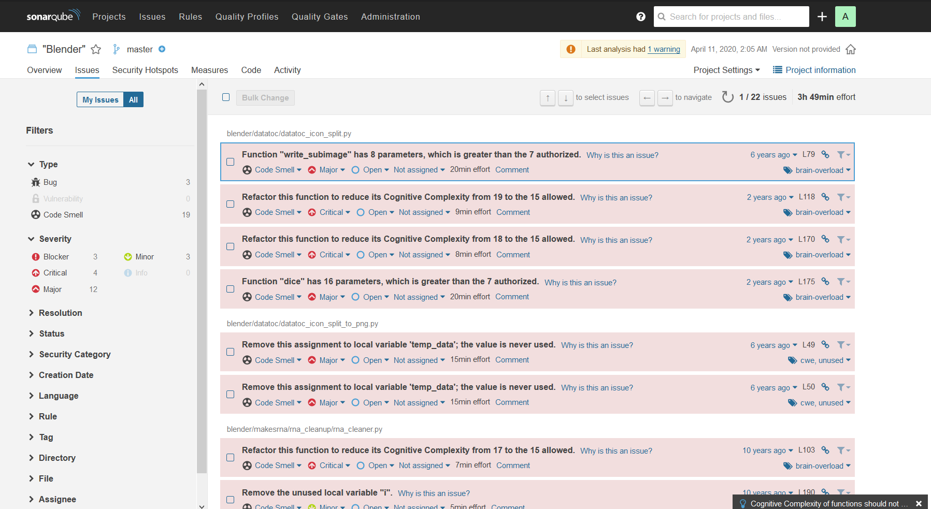
SonarQube – Long Term Development Tool
Easiest tool to use
No installation of complex dependencies or the program itself
Runs off own server batch file
Uses external utility to run actual PA
Limited by “free” features – only checked python files
Results:
 | Bugs | Critical Issues | Code Smells | Vulnerabilities
Unmodified | 1 | 0 | 17 | 0
Modified | 3 | 4 | 19 | 0
Notes:
Analysis appears somewhat limited and inaccurate sometimes requiring the analysis to be ran multiple times before providing accurate results.

Slide 4
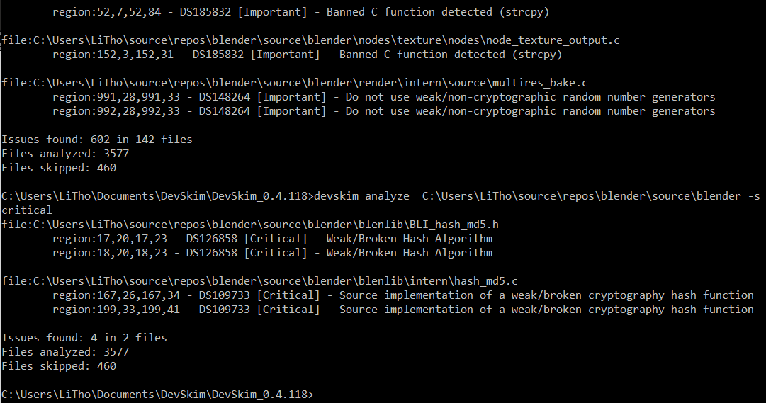
DevSkim – Literal Code Skimmer
Provides the most limited scan of the three
Used to double check developer’s syntax to check for commonly inserted vulnerabilities
Ad-hoc arbritary code
Dead code or Commented code
SSL/TLS exploits and vulnerabilities
Checks only C/C++ code
 | Critical Bugs | Important Bugs
Unmodified | 4 | 599
Modified | 4 | 599
Notes:
SSL stands for Secure Sockets Layer and TLS stands for Transport Layer Security

Slide 5
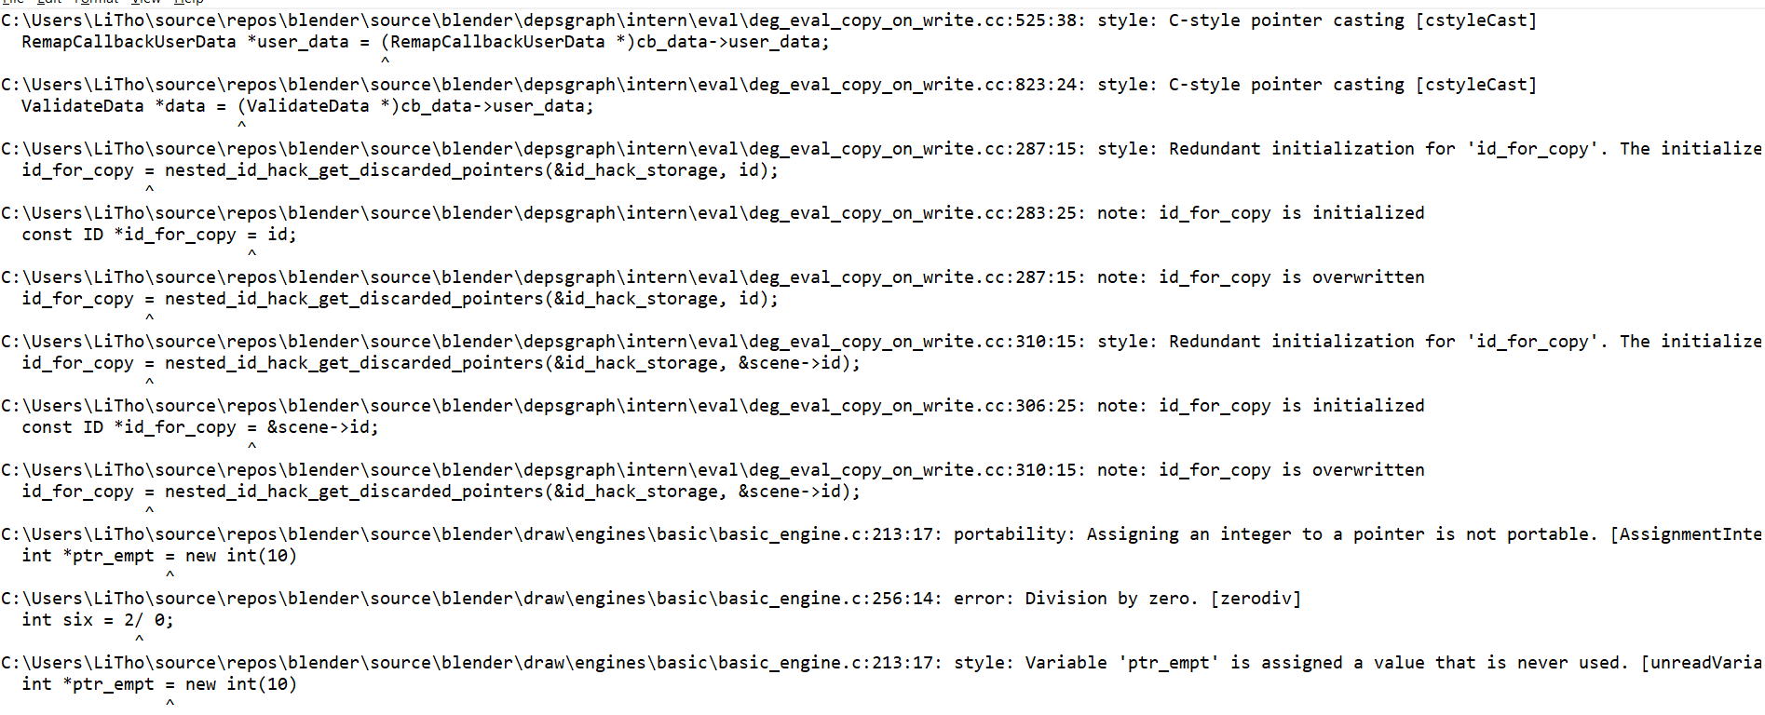
CppCheck – Last-Ditch Program Analysis
Provided a complete scan of C/C++ files
Provided a GUI and Terminal option
GUI always crashed at 50%
Terminal provides a raw dump
Manual sorting and locating of data errors
Complete analysis is too complete and provided redundant results
Bug Type | Variable Scope | Unknown Macro | Memory Leak | Invalid Pointer Cast | Null Pointer Redundant Check | Redundant Initialization | Syntax Error
Unmodified | 2676 | 7 | 0 | 99 | 144 | 23 | 7
Modified | 2676 | 7 | 1 | 99 | 144 | 25 | 7

Slide 6
Conclusion
Different tools solve different problems
Long term development
Avoiding deprecated code
Robust, complete code analysis
Choose the right tool for the right job
Only you can prevent code boiler fires

Slide 7
Questions?
Thank you for your time
Reference Programs
SonarQube: https://www.sonarqube.org/
DevSkim: https://github.com/microsoft/DevSkim
CppCheck: http://cppcheck.sourceforge.net/

